Slide 1

Docker(Dock worker) and Container
Nish Jha

Slide 2
Installer
Docker for Windows(64 bit)
on Hyper-VM
-Enable Hyper_V
Docker for Linux
You can use docker for Linux on docker for Windows.
Install for docker.com
Docker Install
Server Install
Cloud Install

Slide 3
Installer
Powershell/bash :
docker image
Install docker container
-

Slide 4
Bad Old days
Why docker
Container
Image
Docker for windows/Linux (HyperV)
Docker run hello-world
Python docker example
Python, node, .net docker example
Visual studio code Docker

Slide 5
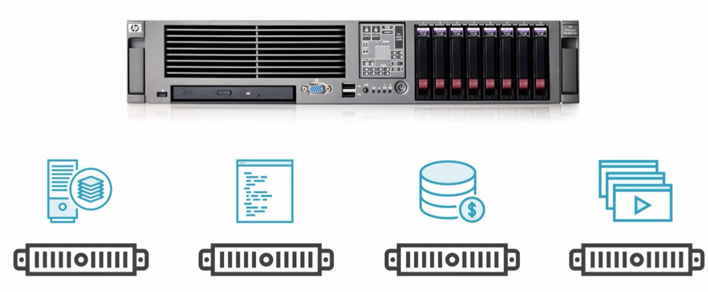
Bad Old Days

Slide 6
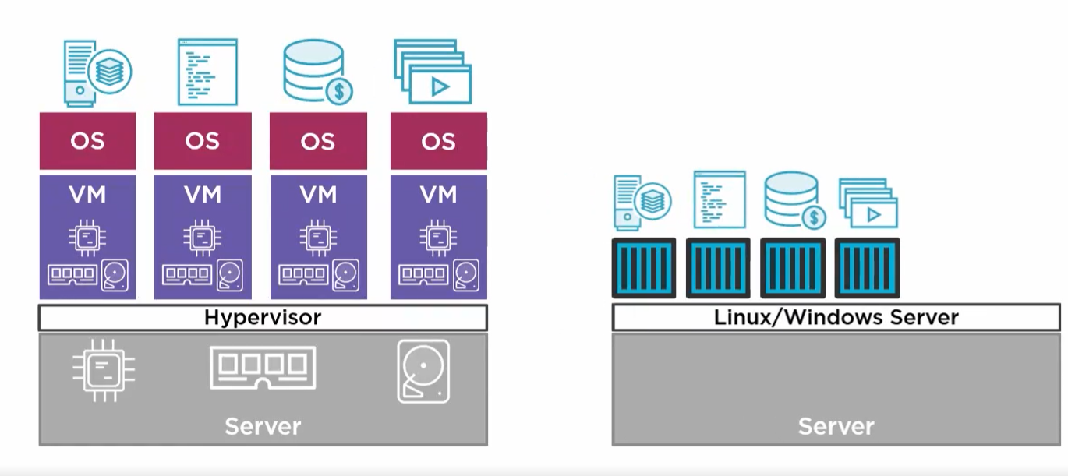
VM Ware vs Container

Slide 7
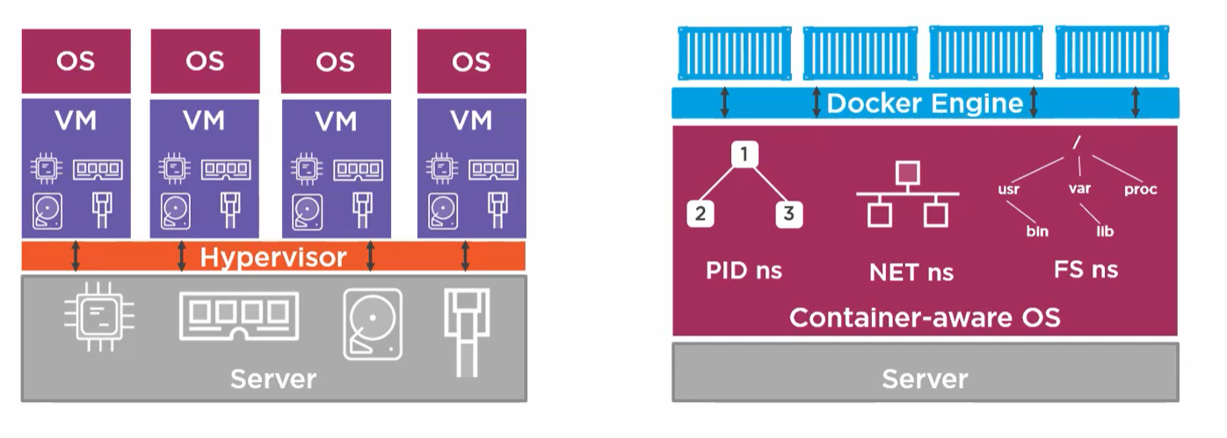

Setting up Morph

Slide 8
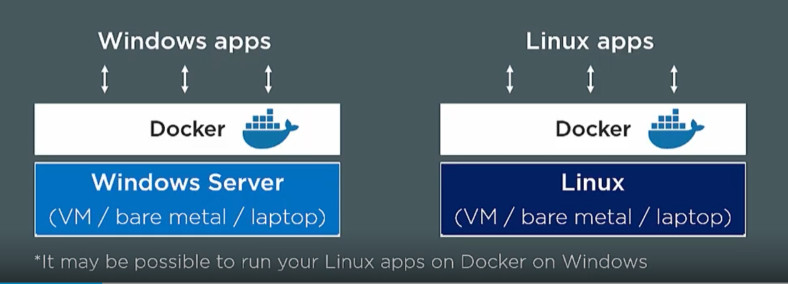

Slide 10


More questions about Docker?
Visit the https://docker.com/
Go to hub.docker.com
Give feedback about this tour
SELECT THE ARROW WHEN IN SLIDE SHOW MODE
Notes:
In Slide Show mode, select the arrows to visit links.

